Slide 1
Linked Lists
CS 201, Summer 2013

Slide 2
ADDITIONAL READING
Linked Lists
  Chapter 17 of Pearson textbook
  http://www.cprogramming.com/tutorial/lesson15.html

Slide 3
Linked List Data Structure
Static arrays are stored in memory with all of their elements next to each other; no gaps.
With Linked Lists, we can point to addresses in memory which are different elements (or nodes) of the list.
A Linked List has a “List” class and an internal “Node” class.

Slide 4


Slide 5
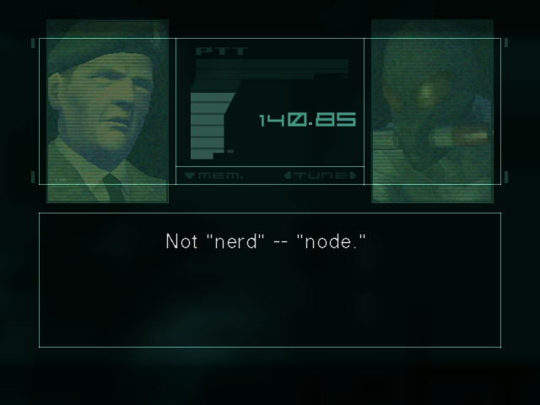

Slide 6
Linked List Data Structure
In a Linked List, we begin with a Node at the beginning.
Each Node points to “nextNode”, but initially new Nodes will point to “NULL”.
0
NULL

Slide 7
Linked List Data Structure
As we add Node elements, each Node only keeps track of what is immediately after it.
Element 0 does not know about Element 2.
0
1
2
NULL

Slide 8
Linked List Data Structure
Because of this, we cannot access a specific index directly like we can with an array
(price[3] = 20.99;)
We end up needing to traverse the Linked List from beginning to the index we want.
0
1
2
NULL

Slide 9
Linked List Data Structure
Get to index 2...
  Begin at start-node
0
1
2
NULL

Slide 10
Linked List Data Structure
Get to index 2...
  Begin at start-node
  Go to 0 → next node
0
1
2
NULL

Slide 11
Linked List Data Structure
Get to index 2...
  Begin at start-node
  Go to 1 → next node
0
1
2
NULL

Slide 12
Linked List Data Structures
To implement this in code, we create a Node class.
Each Node class will have a pointer to another Node (the next node).
Additionally, each Node class will also contain the data to be stored.
  For example, if we were storing prices, we'd have a float variable as a member of our Node class.

Slide 13
Linked List Data Structures
Linked Lists have their own set of Pros and Cons...
  Insertion and Deletion is faster than a normal array (i.e., resizing the array)
    You are just pointing or not pointing to data!
  Getting a specific index is slower than a normal array
    Have to traverse the list!
    No random access.

Slide 14
STL Containers...
STL has the “List” class available for you to use. It is a doubly-linked list.
This means that instead of only pointing to “nextNode”, each Node also points to “previousNode”.
This allows us to traverse from beginning to end and from end to beginning.

Slide 15

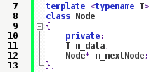
In Code
A node will usually look like this...:
Actual array element's value
Pointer to next element/Node in list
Or we can make it a template:

Slide 16
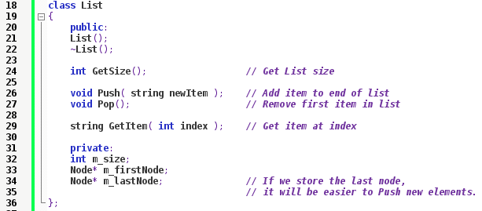
In Code
Then we'll also have a List container class, which contains List functionality and pointers to the first [and last, optionally] nodes.
We might also make List a friend of Node.

Slide 17

List Constructor
The Constructor will simply initialize our Node pointers and set the size equal to 0.

Slide 18
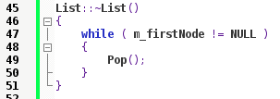
List Destructor
In the Destructor, we'll want to make sure that all memory is freed.
We will call Pop() repeatedly until the list is empty (first node is NULL).

Slide 19
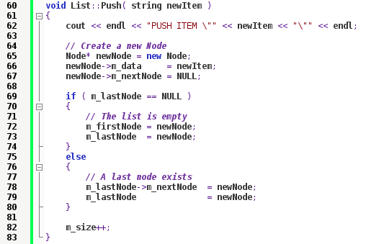
Push
In Push, we will create a new Node and add it to the list.

Slide 20
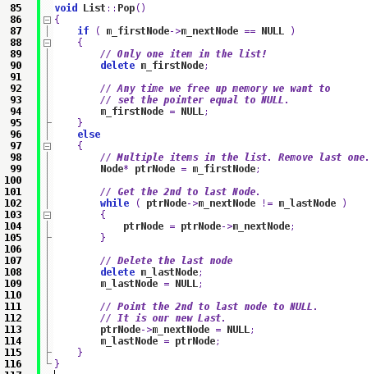
Pop
Pop will remove the last item from the list.

Slide 21
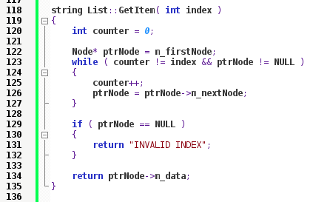
GetItem
And to get an item at some index, we have to traverse the Linked List.

Slide 22
Adding On
You can also write iterators like in the STL library.
You can overload operators like subscript [ ] for a shortcut to the “GetItem” function
You can also add a “Search” function to look for a Node w/ matching data to what the user wants
You could store more than just one piece of data in the Node

Slide 23
Summary
Linked Lists are built in two parts:
  Node – Holds the data & pointer to other Node
  List – contains Nodes & functionality
Main functionality:
  Push
  Pop
  Get Item
Uses dynamically allocated memory

Slide 24
Practice
Let's implement a Linked List as a template!

Slide 25
References
Images from Metal Gear Solid 2, obtained from http://lparchive.org/Metal-Gear-Solid-2-(Screenshot)/Update%207/

